Slide 1

COMP-SCI 5590 - 0003 Special Topics
Mobile App development

Slide 2
Agenda
Camera
Location
Sensors

Slide 3
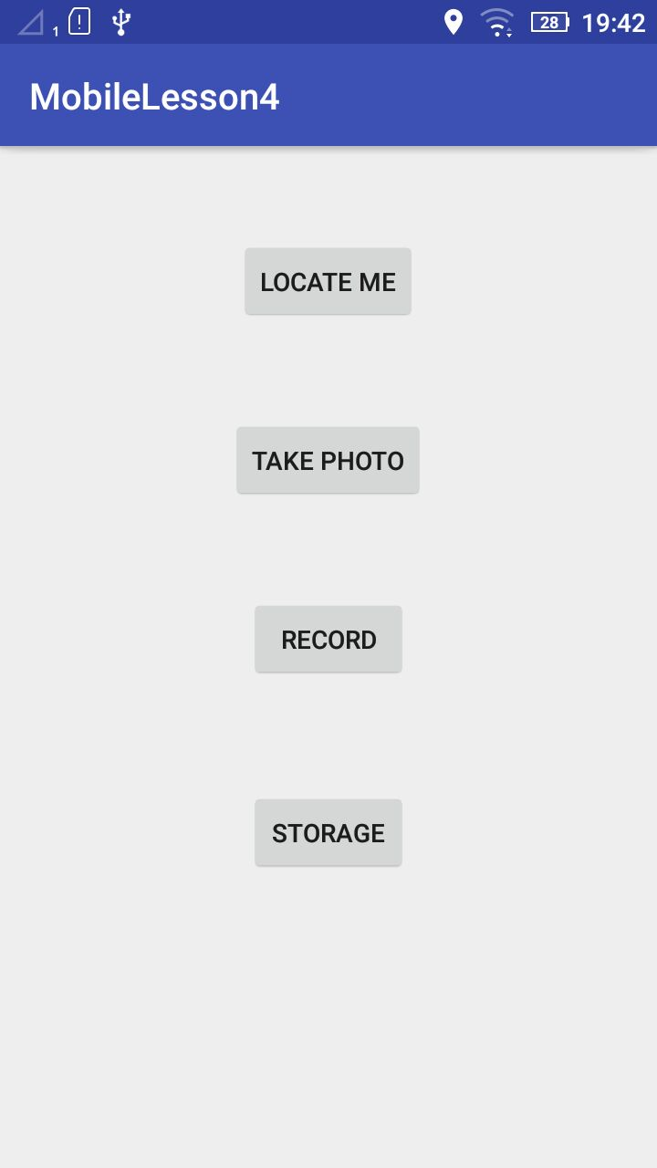
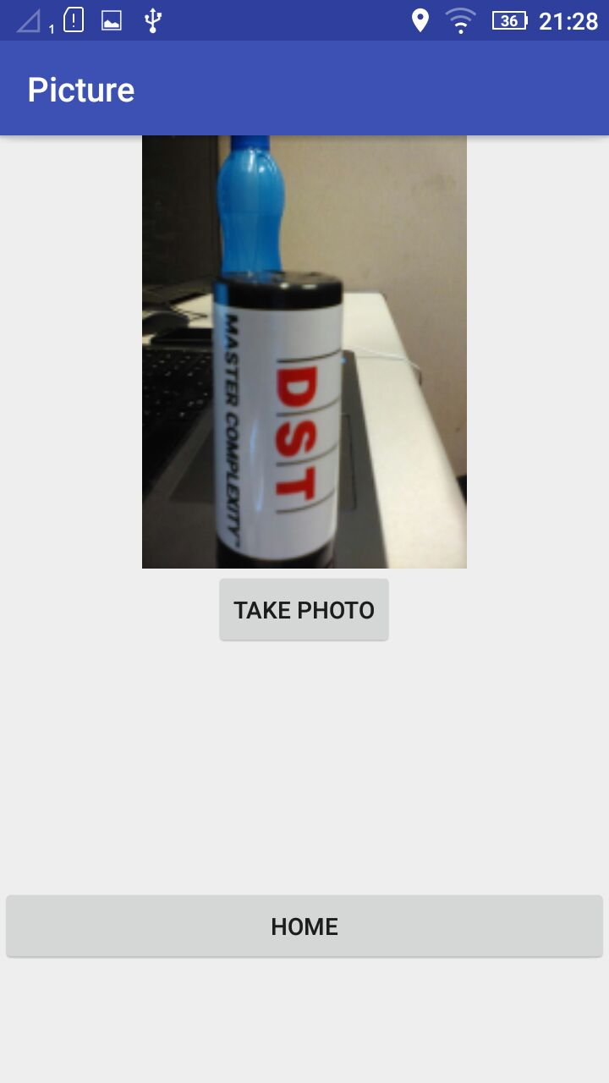
Camera

Slide 4
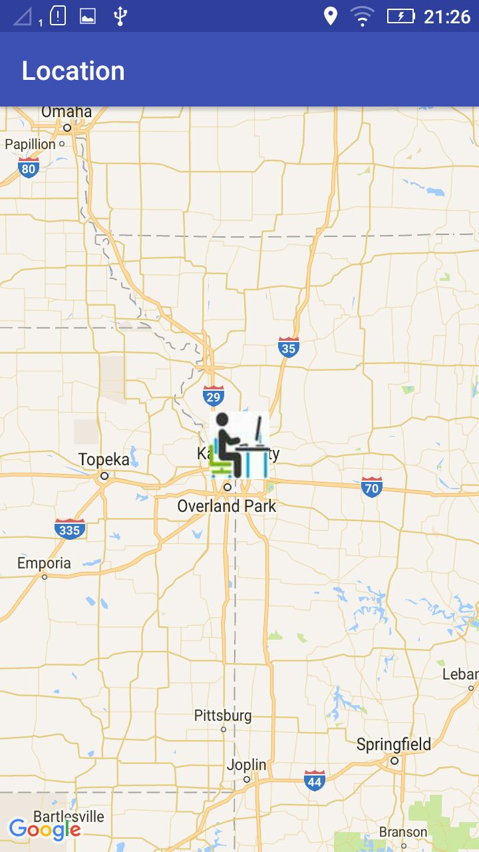
Location

Slide 5
Android Media and Camera
Developers can add Audio, Video and image capabilities to their app using in built libraries in Android.
Eg: Camera Library
Camera can be accessed through android.hardware.camera2
Camera Intent
http://developer.android.com/guide/topics/media/camera.html

Slide 6
Android Location and Maps
Applications can access the location of the user to improve functionality.
android.location package contains the classes and methods for accessing location.
LocationManager is the central component of location framework.
LocationProvider is used to query for the user’s last known location.
http://developer.android.com/guide/topics/location/index.html

Slide 7
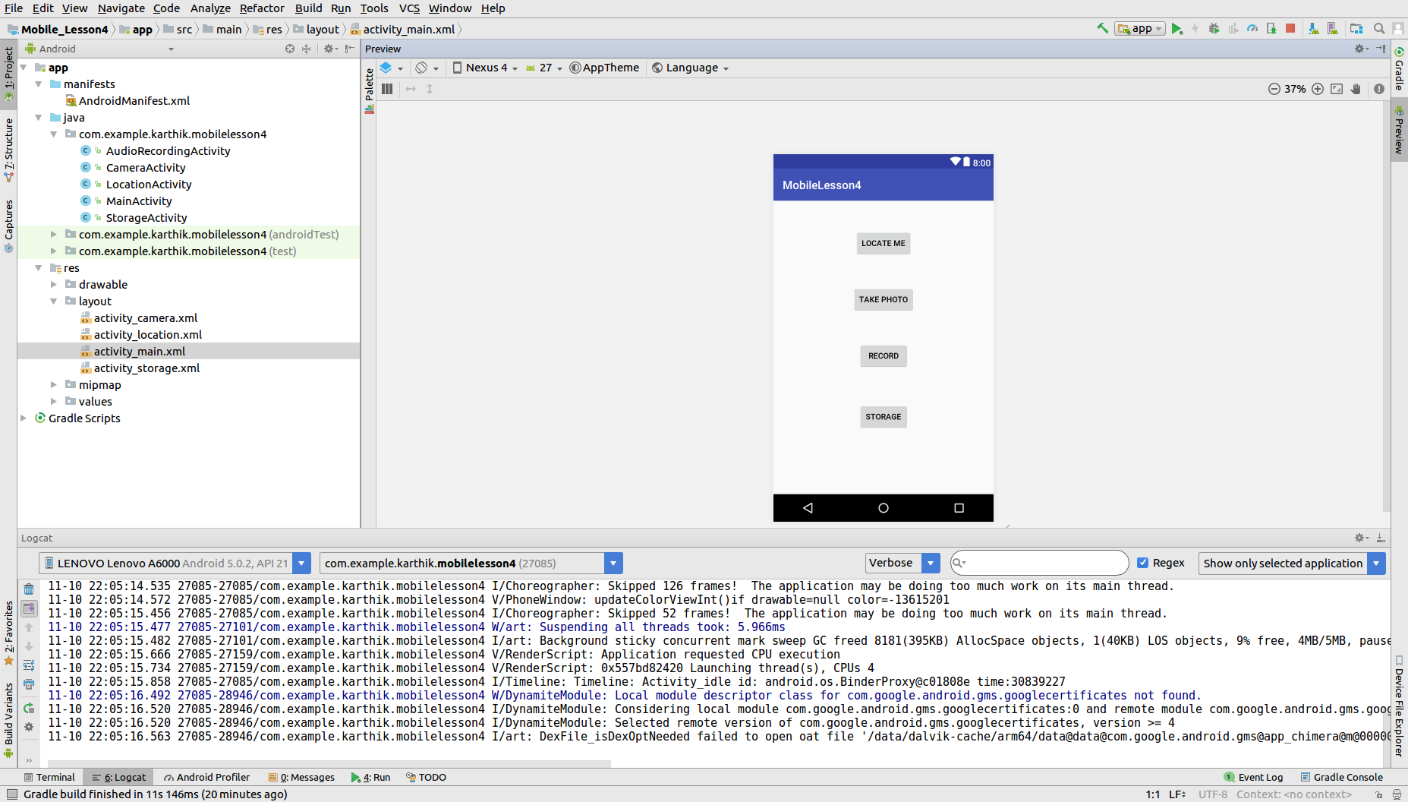
activity_main.xml screen

Slide 8
MainActivity.java code
@Override
protected void onCreate(Bundle savedInstanceState) {
super.onCreate(savedInstanceState);
setContentView(R.layout.activity_main);
button_map = (Button) findViewById(R.id.main_btn_maps);
button_photo = (Button) findViewById(R.id.main_btn_photo);
}
public void onClickOfMapButton(View v) {
//This code redirects the from main page to the maps page.
Intent redirect = new Intent(MainActivity.this, MapsActivity.class);
startActivity(redirect);
}
public void onClickOfPhotoButton(View v) {
//This code redirects to the photo activity.
Intent redirect = new Intent(MainActivity.this, PhotoActivity.class);
startActivity(redirect);
}
Redirection to the selected button
activity.

Slide 9
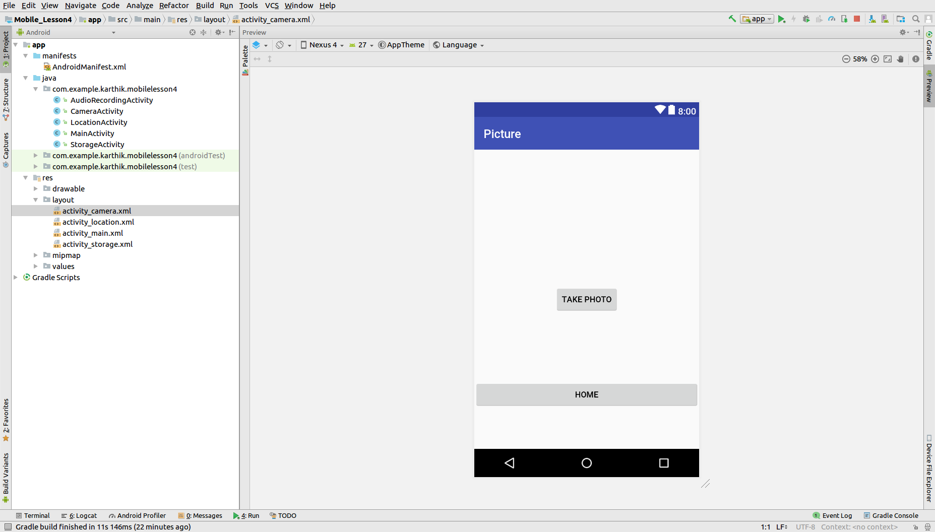
activity_camera.xml screen

Slide 10
CameraActivity.java code
Button capture = (Button) findViewById(R.id.btn_take_photo);
//Button click eventlistener. Initializes the camera.
capture.setOnClickListener(new View.OnClickListener() {
public void onClick(View v) {
Intent cameraIntent = new Intent(MediaStore.ACTION_IMAGE_CAPTURE);
startActivityForResult(cameraIntent, TAKE_PHOTO_CODE);
}
});
@Override
protected void onActivityResult(int requestCode, int resultCode, Intent data) {
super.onActivityResult(requestCode, resultCode, data);
if (requestCode == TAKE_PHOTO_CODE && resultCode == RESULT_OK) {
Bitmap photo = (Bitmap) data.getExtras().get("data");
userImage.setImageBitmap(photo);
Log.d("CameraDemo", "Pic saved");
Accessing the device camera and starting it.
If successful in capturing the image it redirects to OnActivityResult
Inside OnActivityResult we set the imageView with the image captured.

Slide 11
LocationActivity.java code
if (ActivityCompat.checkSelfPermission(this, Manifest.permission.ACCESS_FINE_LOCATION)
!= PackageManager.PERMISSION_GRANTED && ActivityCompat
.checkSelfPermission(this, Manifest.permission.ACCESS_COARSE_LOCATION)
!= PackageManager.PERMISSION_GRANTED) {
//show message or ask permissions from the user.
return;
}
//Getting the current location of the user.
userCurrentLocation.requestLocationUpdates(LocationManager.GPS_PROVIDER, 0, 0, userCurrentLocationListener);
latitute = userCurrentLocation .getLastKnownLocation(LocationManager.GPS_PROVIDER).getLatitude();
longitude = userCurrentLocation.getLastKnownLocation(LocationManager.GPS_PROVIDER)
.getLongitude();
userCurrentLocationCoordinates = new LatLng(latitute,longitude);
https://developers.google.com/maps/documentation/android-api/start#get-key

Slide 12
LocationActivity.java code
Getting the address of the user based on latitude and longitude.
try {
List<Address> addresses = geocoder.getFromLocation(latitude, longitude, 1);
Address address = addresses.get(0);
userAddress = new StringBuilder();
for (int i = 0; i < address.getMaxAddressLineIndex(); i++) {
userAddress.append(address.getAddressLine(i)).append("\t");
}
//Setting our image as the marker icon.
mMap.addMarker(new MarkerOptions().position(userCurrentLocationCoordinates)
.title("Your current address.").snippet(userAddress.toString())
.icon(BitmapDescriptorFactory.fromResource(R.drawable.marker_maps)));
//Setting the zoom level of the map.
mMap.moveCamera(CameraUpdateFactory.newLatLngZoom(userCurrentLocationCoordinates, 7));

Slide 13
Sensors
Motion sensors: measure acceleration & rotational forces along three axes.
Eg: accelerometers, gravity sensors, gyroscopes
Environmental sensors: measure environmental parameters
Eg: barometers, photometers, and thermometers.
Position sensors: measure the physical position of a device.
Eg:orientation sensors and magnetometers.
https://developer.android.com/guide/topics/sensors/sensors_overview.html

Slide 14
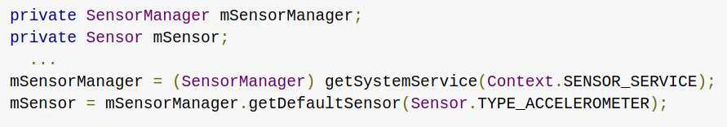
Motion Sensors-Accelerometer
measures the acceleration applied to the device, including the force of gravity
// get an instance of the default acceleration sensor:

Slide 15
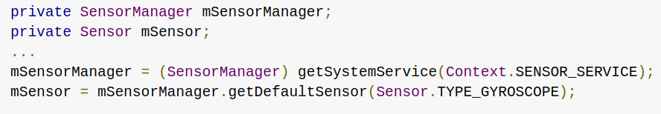
Motion Sensors-Gyroscope
measures the rate of rotation in rad/s around a device's x, y, and z axis
// get an instance of the default gyroscope sensor:

Slide 16
References
https://developer.android.com/index.html
https://developers.google.com/android/for-all/vocab-words/
https://classroom.udacity.com/courses/ud836

